Slide 1
DISCUSSION HOUR Relational Algebra
Dr.Sikha O K
Assistant Professor(Sr.Gr)
Computer Science and Engineering Department
ASE-Coimbatore
Ms.Vidhya S
Assistant Professor(Sr.Gr)
Computer Science and Engineering Department
ASE-Coimbatore

Slide 2
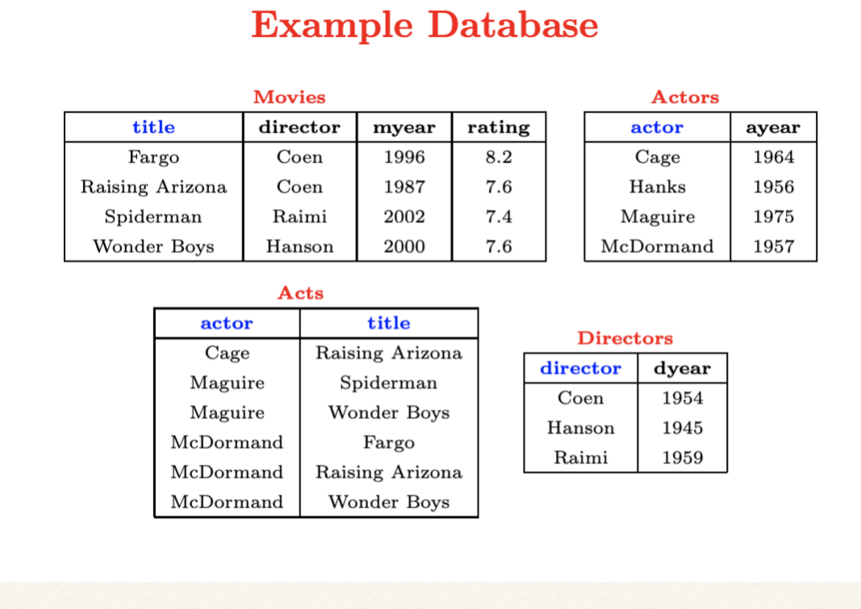
Example Database

Slide 3
Write Relational Algebra Expressions for the following
Find movies made after 1997
Find movies made by Hanson after 1997
Find all movies and their ratings
Find all actors and directors
Find Coen’s movies with McDormand
Find movies with Maguire but not McDormand
Find actors who have acted in some Coen’s movie
Find (director, actor) pairs where the director is younger than the actor
Find actors who have acted in all of Coen’s movies

Slide 4
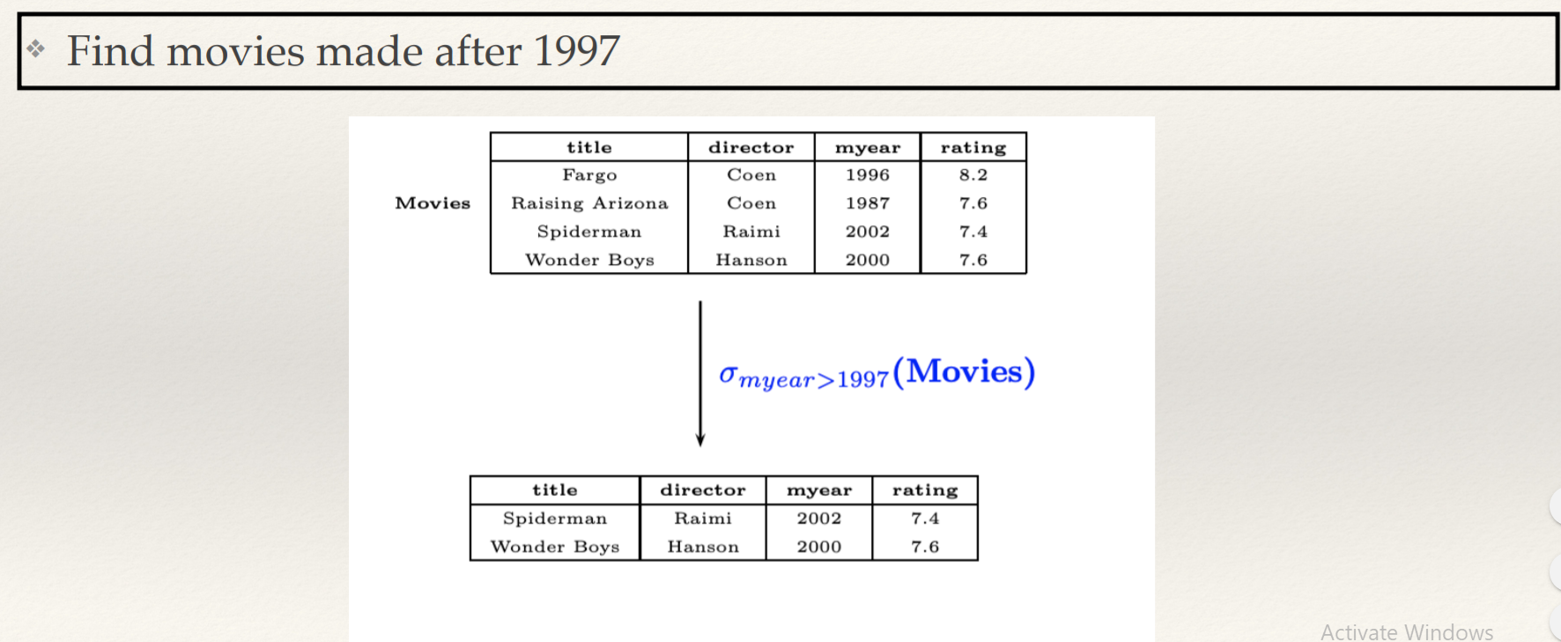
Q1

Slide 5
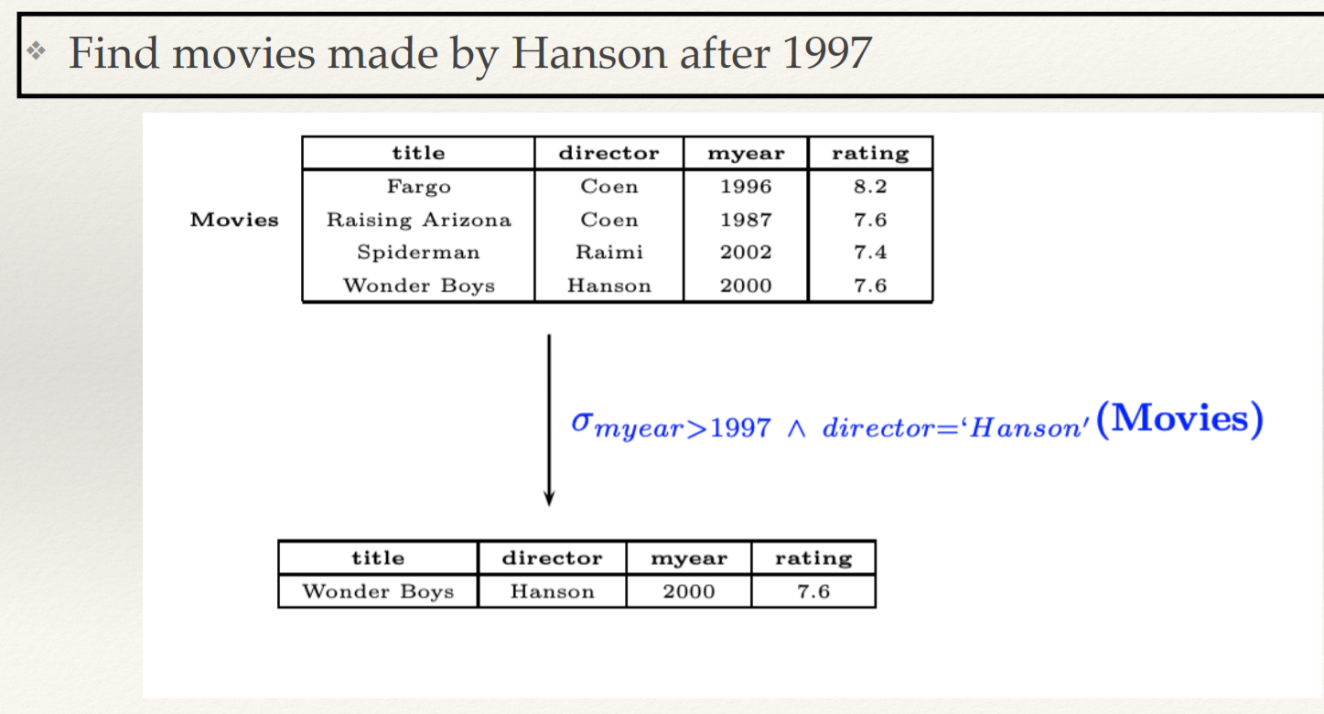
Q2

Slide 6
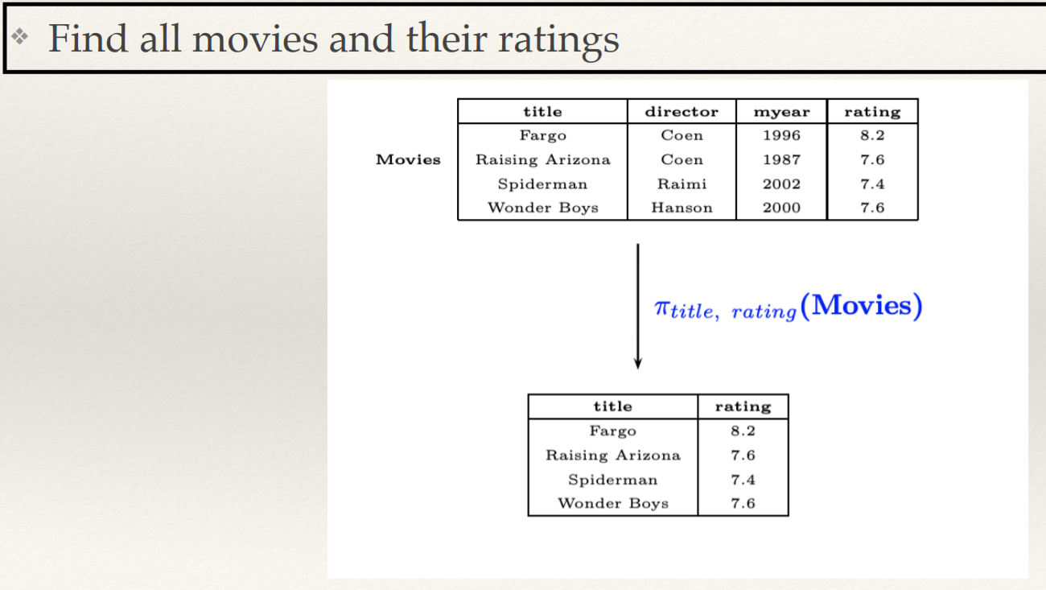
Q3

Slide 7
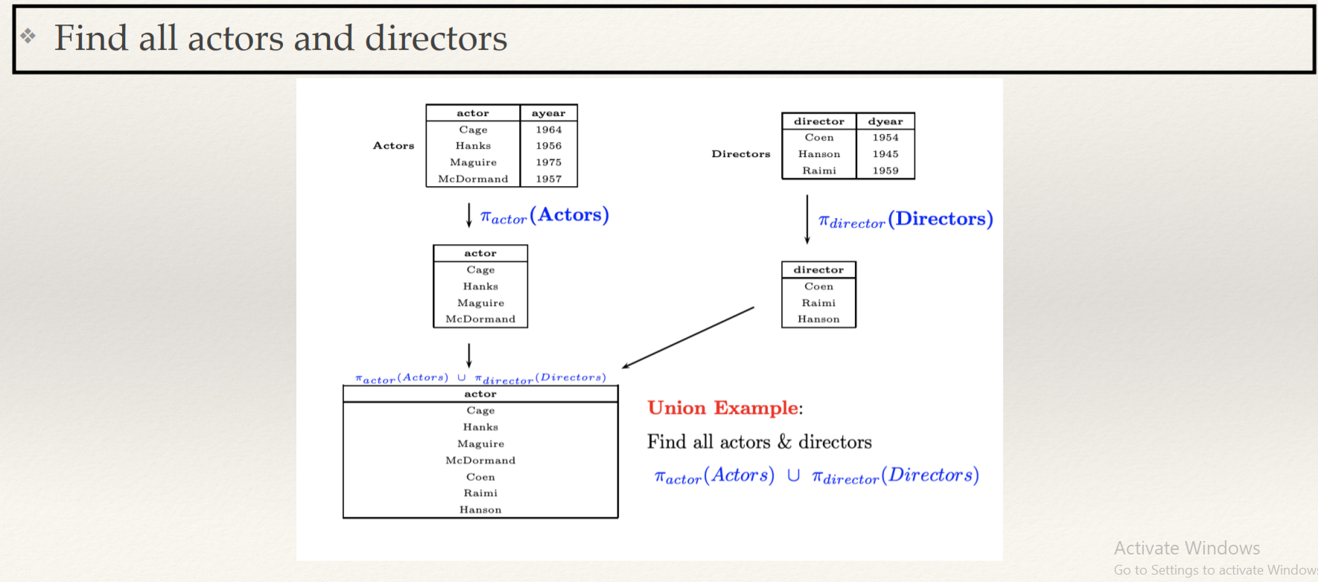
Q4

Slide 8
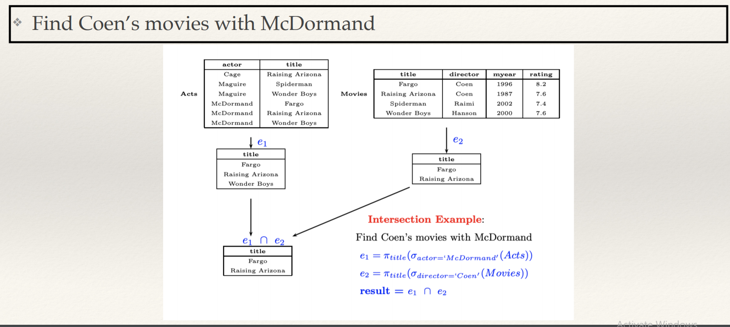
Q5

Slide 9
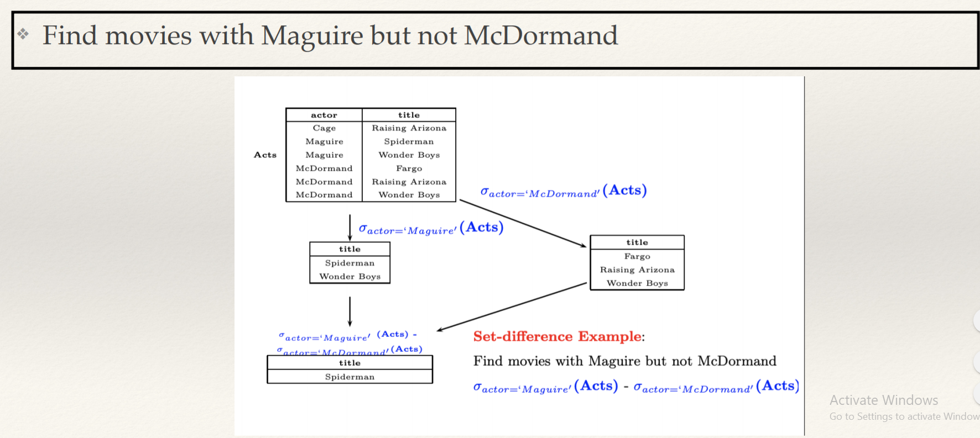
Q6

Slide 10
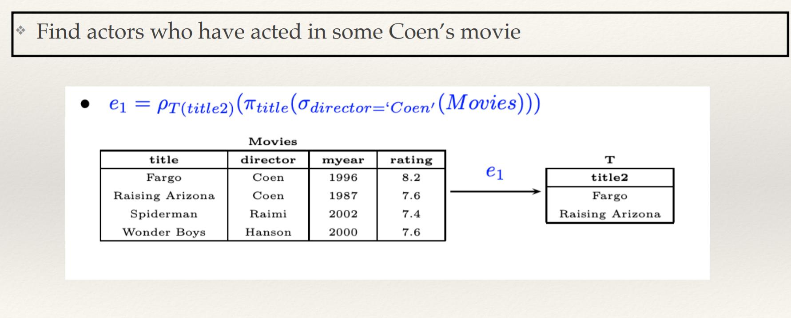
Q7

Slide 11
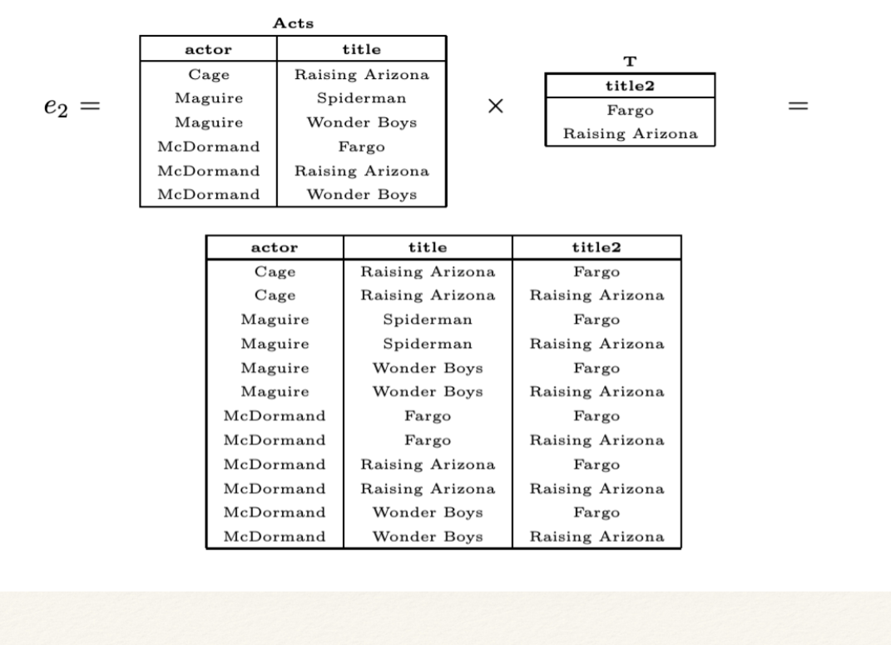

Slide 12
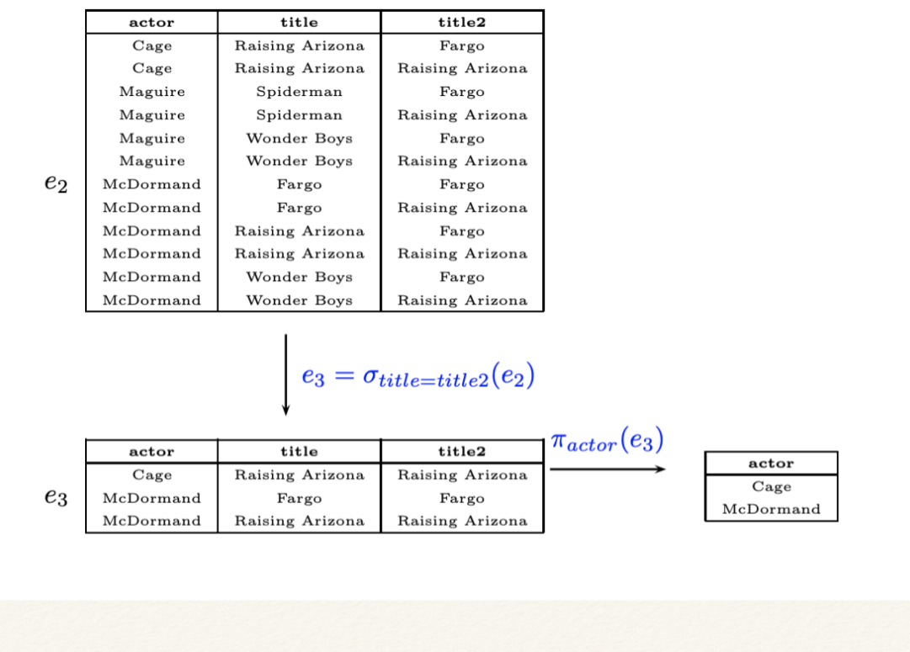

Slide 13
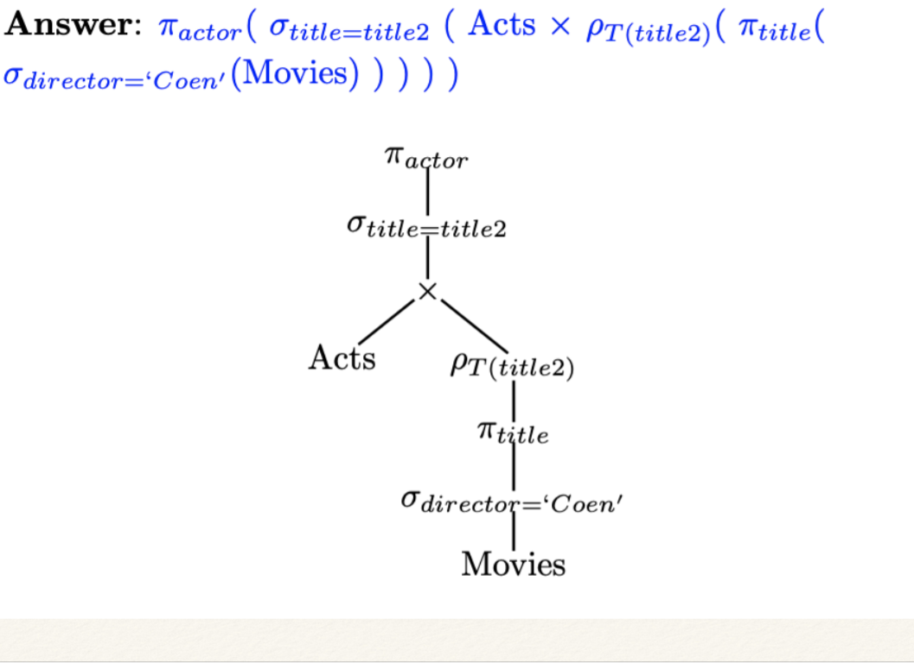

Slide 14
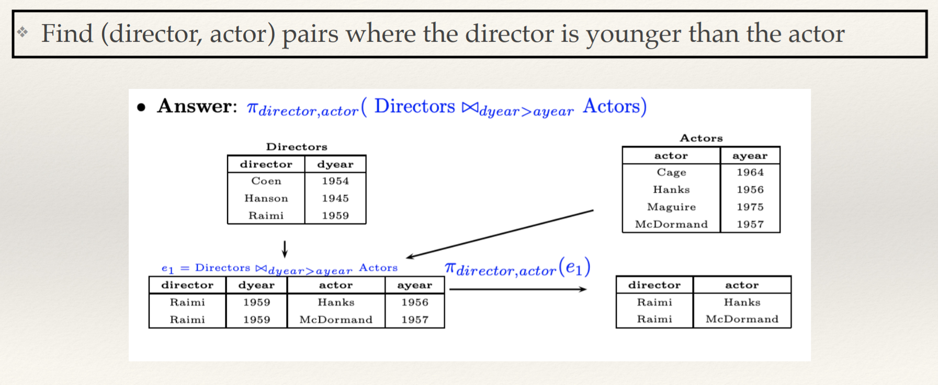

Slide 15
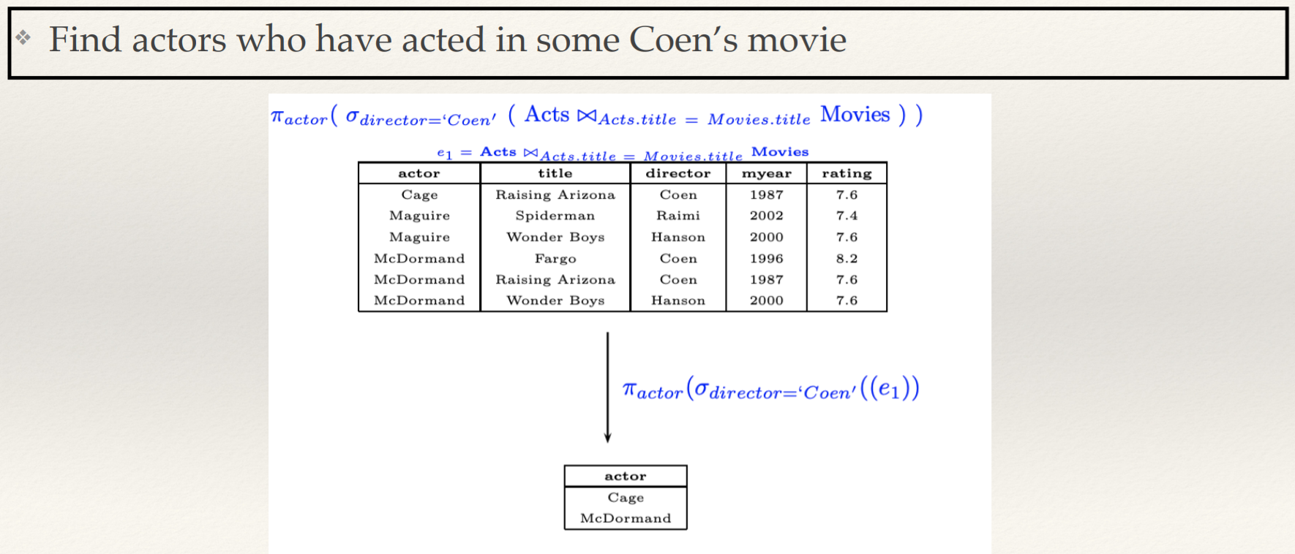

Slide 16
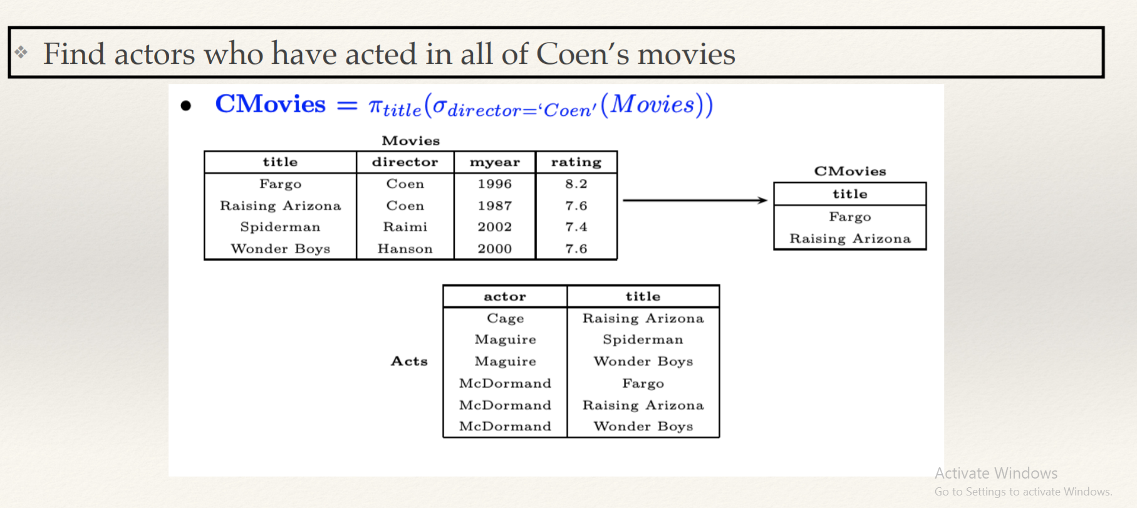

Slide 17
Consider the Publisher Database Schema
Author(author id; first name; last name)
Author_pub(authorid; pub id; author position)
Book(bookid; book title; month; year; editor)
Publisher(pubid; title; book id)
1. Write relational algebra query to display the title of books from Book table?

Slide 18
Consider the Publisher Database Schema
Author(author id; first name; last name)
Author_pub(authorid; pub id; author position)
Book(bookid; book title; month; year; editor)
Publisher(pubid; title; book id)
2. Write a relational algebra expression that returns the book id and title of books which are published

Slide 19
Consider the Publisher Database Schema
Author(author id; first name; last name)
Author_pub(authorid; pub id; author position)
Book(bookid; book title; month; year; editor)
Publisher(pubid; title; book id)
3. What question does the following relational algebra expression answer?
Which authors authored a pub that was published in July?

Slide 20
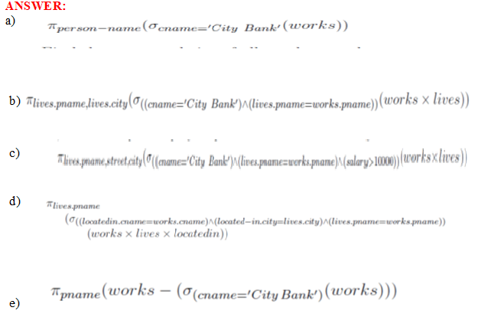
Consider the following schema and write RELATIONAL ALGEBRA EXPRESSION for the following
Lives(person-name,street,city)
Works(person-name, company-name,salary)
Located-in(company-name,city)
Manages(person-name,manager-name)
Find the name of all employees (i.e., persons) who work for the City Bank company (which is a specific company in the database).

Slide 21
2. Consider the following schema and write RELATIONAL ALGEBRA EXPRESSION for the following
Lives(person-name,street,city)
Works(person-name, company-name,salary)
Located-in(company-name,city)
Manages(person-name,manager-name)
b. Find the name and city of all employees who work for City Bank.

Slide 22
2. Consider the following schema and write RELATIONAL ALGEBRA EXPRESSION for the following
Lives(person-name,street,city)
Works(person-name, company-name,salary)
Located-in(company-name,city)
Manages(person-name,manager-name)
c. Find the name and city of all employees who work for City Bank.

Slide 23
2. Consider the following schema and write RELATIONAL ALGEBRA EXPRESSION for the following
Lives(person-name,street,city)
Works(person-name, company-name,salary)
Located-in(company-name,city)
Manages(person-name,manager-name)
d. Find the name, street and city of all employees who work for City Bank and earn more than Rs.10,000.

Slide 24
2. Consider the following schema and write RELATIONAL ALGEBRA EXPRESSION for the following
Lives(person-name,street,city)
Works(person-name, company-name,salary)
Located-in(company-name,city)
Manages(person-name,manager-name)
e. Find all employees who live in the same city as the company they work for.

